Slide 1

Krish Lakshmi Narayanan
Final Project Oral Presentation

Slide 2
Summary
Objective: Build a machine learning model to predict salaries based on various features.
Approach:
Preprocessing data to remove outliers and handle categorical variables
Feature engineering to create meaningful new variables
Model selection and tuning using methods like GBM, Random Forests, and XGBoost
Outcome: The final XGBoost model achieved optimal performance based on RMLSE metrics.

Slide 3
Preprocessing & Transfomation
Preprocessing:
Removed outliers in the salary variable using statistical methods (e.g., Cook's Distance).
Converted categorical variables to factors for modeling purposes.
Transformed date variables into usable formats (e.g., year, month, day).
Circular Encoding of month variate
Applied log transformation to the salary variable to reduce skewness and normalize data distribution
Benefits of Log Transformation:
Handled large variations in salary values.
Improved model accuracy by stabilizing variance

Slide 4
Feature Engineering
Created new features from existing data:
Date-Based Variables: Year, month, day, day_of_week, is_weekend
Cyclical encoding: captured periodicity using month_sin, month_cos
Hockey performance metrics: Net possession control, Plus-Minus per Minute, Points per Game, Physcality, Relative Corsi per Time on Ice
Additionally, based on Multicollinearity, features with high GVIF values were dropped so that there was no feature that had a VIF of more than 2

Slide 5
Model Overview
Final Model: XGBoost
Formula used: log(salary) ~ team + toi + gp + pos + nat + age + injure + day + is_weekend + month_sin + month_cos + npc + pm_per_min + ppg + physicality + relCorsi_per_toi
Feature selection: Features with importance > 0 were retained for the final model

Slide 6
Model Building Process
Explored Methods:
Gradient Boosting (GBM)
Random Forests
Boosted Trees (Course notes)
XGBoost (Final Choice)
Model Selection Criteria:
Lowest Root Mean Log Squared Error (RMLSE) on test samples
Training sample RMLSE to assess Model fit
Cross-validation:
Used Grid-search for hyperparameter tuning

Slide 7
GBM Model Development
Gradient Boosting Model (GBM):
Cross-validation was performed to tune parameters like shrinkage, number of trees, and bag fractions.
Feature Selection: Models were built with varying numbers of features (e.g., top 3, top 5, top 7).
Evaluation Metrics: Cross-validation error was minimized for optimal parameter selection
Reiteration of the above steps were done to fine tune and select the model with the optimal parameters

Slide 8
Random Forest Model Development
Cross-validation was performed to determine the optimal number of features (n.var) for minimizing error.
Top features were selected iteratively, and models were rebuilt with reduced feature sets:
Features like toi, ppg, gp, and nat were consistently ranked high in importance
Random Forest models were evaluated using cross-validation error and feature importance metrics and RMLSE of training and testing samples

Slide 9
Boosted Models
Boosting Methodology:
Boosting was used to iteratively improve predictions by fitting residuals from previous models
Boosting function was implemented using residual updates using the custom function in the course notes:
Trees were sequentially added with a learning rate (lam) of 0.01 and up to 1,000 iterations
Boosted models were again evaluated based on RMSE of the testing set and the fit on the training dataset was also evaluated

Slide 10
XGBoost Model
We setup the base model using the formula: log(salary) ~ team + toi + gp + pos + nat + age + injure + day + is_weekend + month_sin + month_cos + npc + pm_per_min + ppg + physicality + relCorsi_per_toi
We perform a grid-search using cross-validation to hypertune the parameters and fit the next model
Feature Selection Process:
Features with importance > 0 were retained for the final model

Slide 11
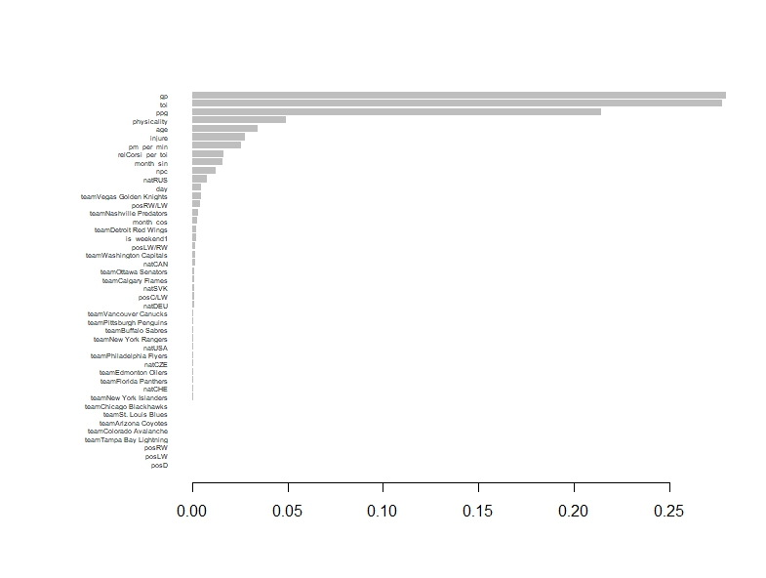
Variates importance Final Model

Slide 12
Final Model Evaluation
Final model Performance metrics:
Training set RMLSE:
Test set RMLSE: 0.29589 (from Kaggle)

Slide 13
Thank You

